Slide 1
What's New in APRN Regulation
Leslie Larson DNP, RN, APRN, CNP, PMHS, PHN
Nursing Practice Specialist
Minnesota Board of Nursing

Slide 2
Objectives
Provide update on current federal legislation related to APRNs
Discuss status of the Nurse and APRN Licensure Compacts
Review of Ramsey County District Court Ruling in Doe v. Minnesota

Slide 3
Federal Legislation Updates

Slide 4
Improving Care and Access to Nurses (ICAN) Act HR 8812
Introduced by Representative Roybal-Allard of California and Representative Joyce of Ohio.
Gaining bipartisan support
Improve healthcare access for Medicare and Medicaid beneficiaries by removing barriers for APRNs
Nursing Association Support ICAN Act
Joyce, Roybal-Allard Introduce Bipartisan Bill to Increase Access to Nurses - Dave Joyce (house.gov)

Slide 5
Improving Care and Access to Nurses (ICAN) Act HR 8812
Removes administrative and practice barriers
Order and supervise cardiac and pulmonary rehabilitation
Order diabetic shoes
Refer for medical nutrition therapy
Certify and recertify a patient’s terminal illness for hospice eligibility
Perform all mandatory exams in skilled nursing facilities

Slide 6
Other Federal Legislation
HR 6087 - Improving Access to Workers' Compensation for Injured Federal Workers Act of 2022
HR 6308 - ACO Assignment Improvement Act of 2021
HR 1956 and S 1986 - Increasing Access to Quality Cardiac Rehabilitation Care Act of 2021
HR 4870 and S 800 - Improved Medicare Patient Access to Needed Therapeutic Shoes
Advocacy Center (aanp.org)

Slide 7
Nurse Licensure Compact Updates

Slide 8
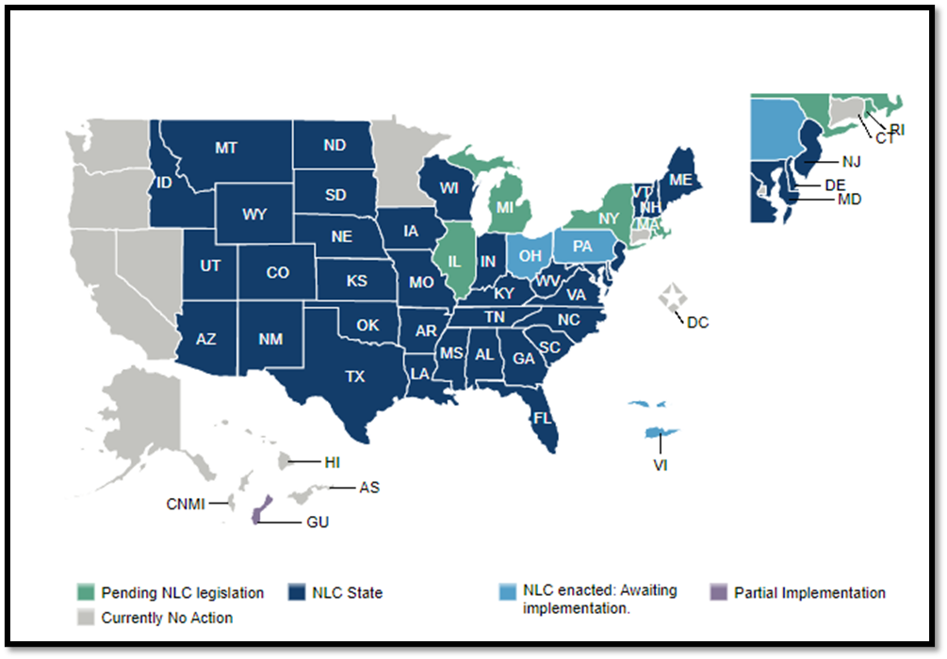
Nurse Licensure Compact
39 Jurisdictions
Maintains public protection while increasing access to care.
Enables nurses to provide in-person and telenursing to patients across the country with a single multi-state license.
Eliminates need to maintain multiple licenses
About the NLC | NLC (nursecompact.com)
Nurse Licensure Compact (NLC) | NCSBN

Slide 9
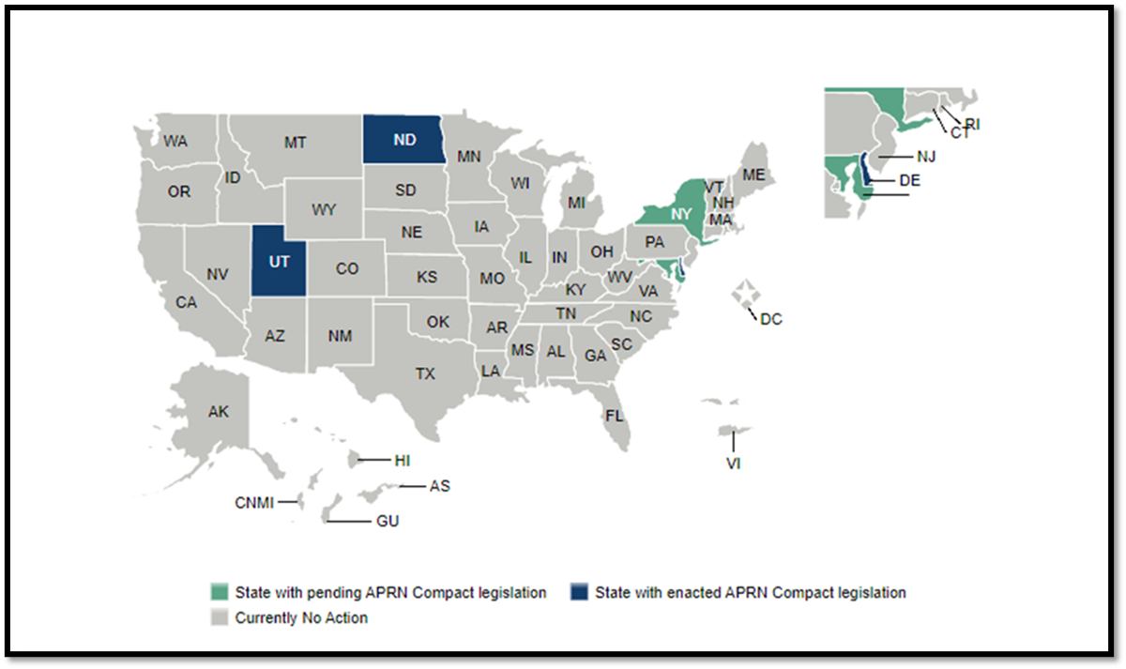
APRN Compact
Allows APRNs to hold one multistate license.
Will be implemented when 7 states have enacted legislation.
Facilitates exchange of information
Promotes uniform licensure requirements
Decreases redundancies
Provides opportunities of interstate practice
APRN_Key_Provisions_2020.pdf (ncsbn.org)
APRN Compact | NCSBN

Slide 10
Minnesota

Slide 11
Abortion Ruling
Ramsey County District Court Ruling in Doe v. Minnesota.
Abortion restrictions deemed unconstitutional
24-hour waiting period
Informed consent script
Requirement that minors notify both parents
Limitation that only physicians can perform abortions
Abortions after first trimester must be carried out in a hospital
A court ruling struck down most of Minnesota’s abortion restrictions this month. What abortion laws are on the books? | MinnPost

Slide 12
Questions

Slide 13
Tip - Be on High Alert for Phishing Scams
Scammers are targeting nurses by sending them official looking letters from nursing regulatory bodies or other state/federal agencies. Anything received regarding personal information or private financial information should be scrutinized.
For more information including the best practices to avoid these types of phishing scams, please read the Be on High Alert for Spear Phishing Scams document published by NCSBN.
DEA Warns Public of Extortion Scam by DEA Special Agent Impersonators (mn.gov)
NCSBNAlert-SpearPhishing-final.pdf

